Slide 1
Week 7 Optional Activities

Slide 2
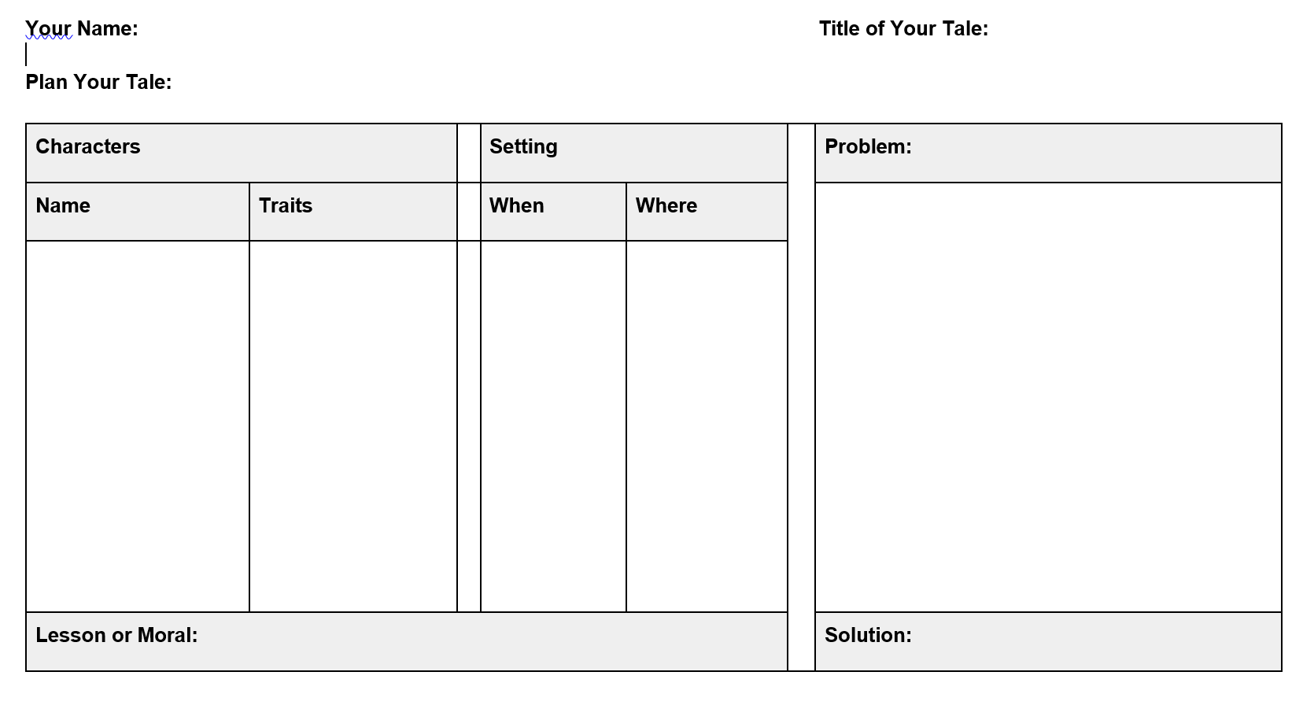
OPTIONAL: Let’s Plan!
Start writing your own folktale: think about the wishes, hopes, fears, or values of a group of people and includes a lesson to be learned (the central message).
Use a planning sheet to help organize your ideas.

Slide 3
Optional-First: Set a Goal!
You have begun writing your own folktale that expresses the wishes, hopes, fears, or values of a group of people and includes a lesson to be learned (the central message).
Stop & Jot: What’s next? Tell us your goal for today. What step do you need to take today to continue your writing?
Join us on Padlet, say hello and post your thoughts on the classroom bulletin board here!

Slide 4
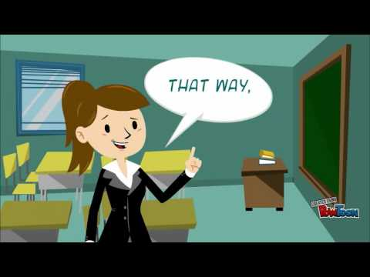
Optional-Next: Draft Your Plan!
Return to your plan: think about the wishes, hopes, fears, or values of a group of people and includes a lesson to be learned (the central message).
Use the “drafting” portion of your planning sheet to help write your ideas.
Here’s a quick video to help you get started!

Slide 5
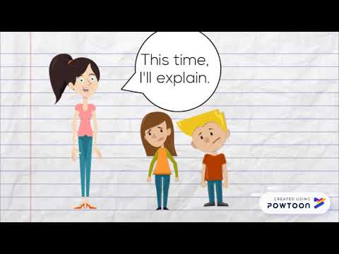
Optional-Then: Edit/Revise your Tale!
Have a look at your draft. What can you learn from this video that can help you edit and revise your tale?

Slide 6
Optional-Finally: Let’s Review!
You began writing your own folktale that expresses the wishes, hopes, fears, or values of a group of people and includes a lesson to be learned (the central message).
Stop & Jot: What did you accomplish today? What support do you need to be successful?
Join us online, post your thoughts on the classroom bulletin board here
** If you would like to share your work with your classmates, let your teacher know!

Slide 7
Optional-Next: Let’s Write!
Return to your draft and now write your final piece! You will need some time to concentrate!
Try listening to some music as you write/type.

Slide 8
Optional- Then: Publish your Paper
Now that you have finished your folktale, here is a way you can share your writing with the world:
http://teacher.scholastic.com/writewit/mff/folktale_publish.asp

Slide 9
Optional-Finally: Reading Party!
Listen to the folktales written by your classmates. We will share these in our zoom meetings!
.

